Slide 1

Project on Healthcare Management System
Swarneem Nandanwar

Slide 2
Technologies used
Fontend: Angular
Backend: Springboot
Databsae: MySQL
Styling: CSS and Bootstrap

Slide 3
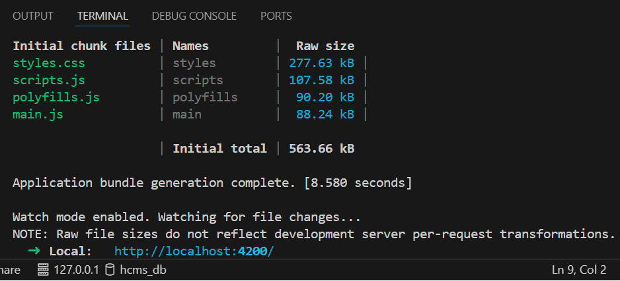
Starting the Application
Start the application using ng serve command.
It is hosted on http://localhost:4200/

Slide 4
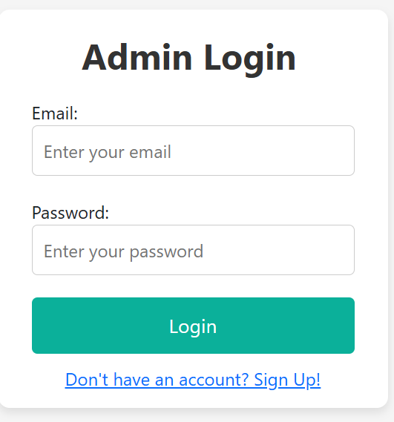
Login Component
User has to first register.
On three failed login attempts user account will be blocked for specific time.

Slide 5
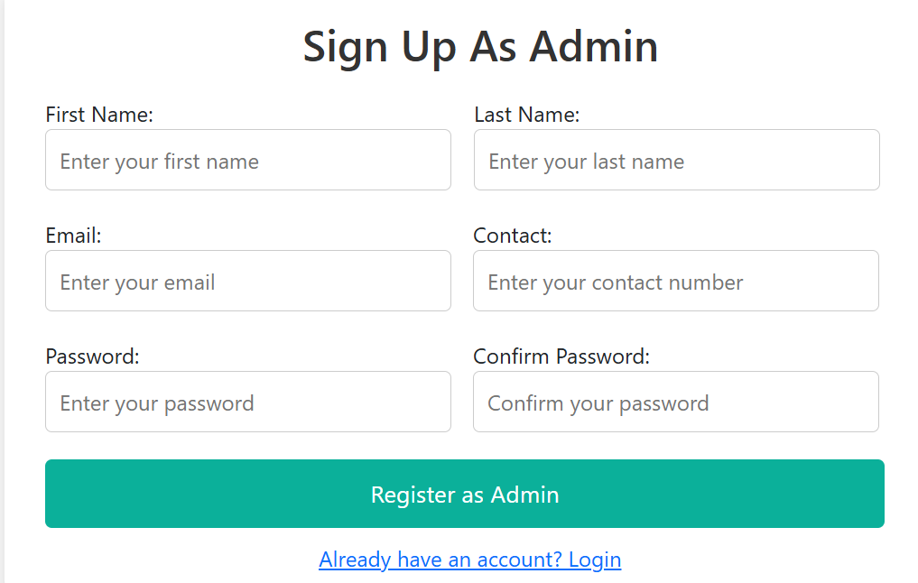
Register Component
The app contains only admin registrations.
On registering admin can login and access the application.

Slide 6
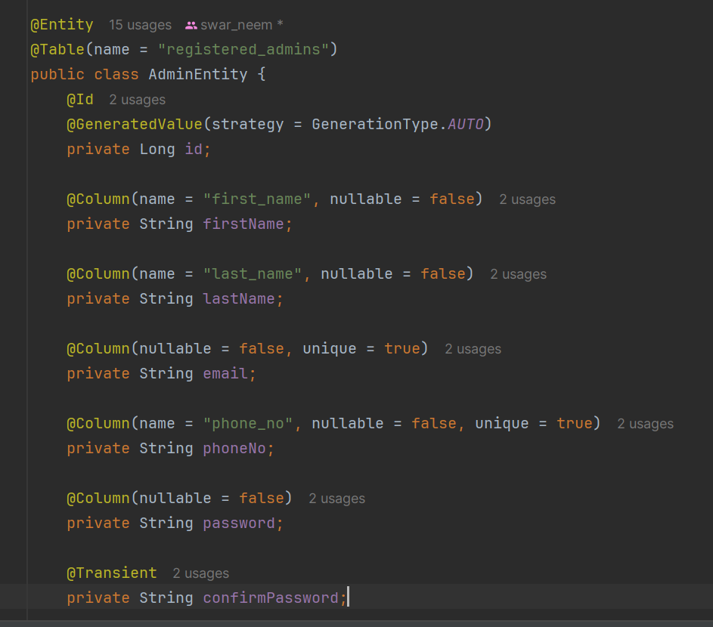
Generating Database using Hibernate
Tables can be automatically created using hibernate.
The @Transient keyword wont generate the table in database

Slide 7
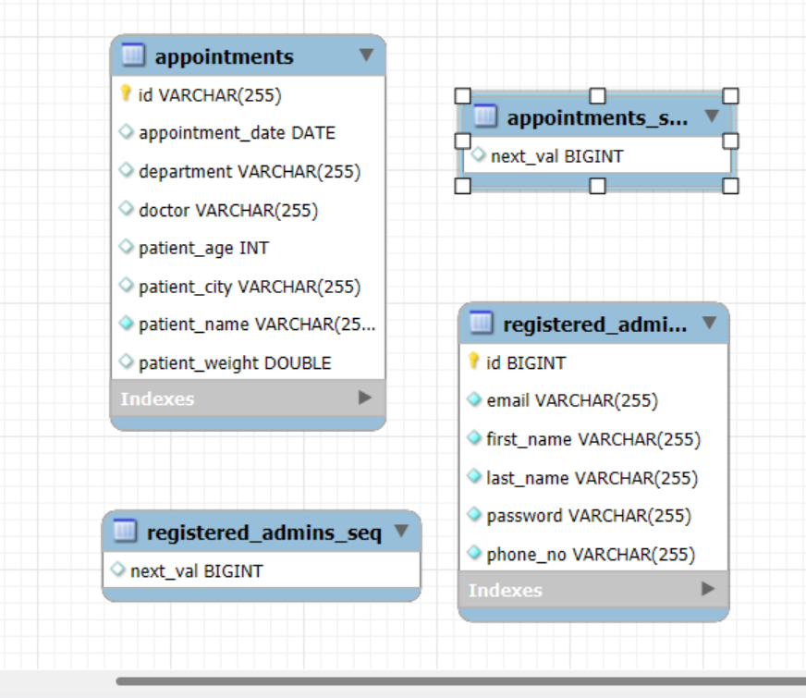
Database Diagram

Slide 8
Home Page
After successful login user will be redirected to Home page.
Admin can book an appointment, delete an appointment and edit an appointment as well.

Slide 9
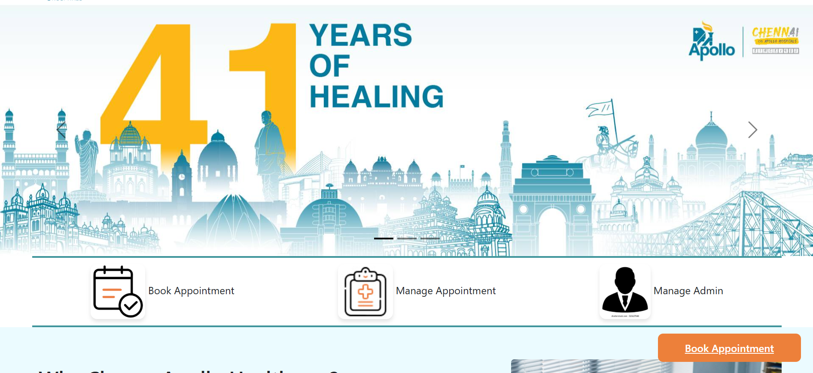
Home Page

Slide 10
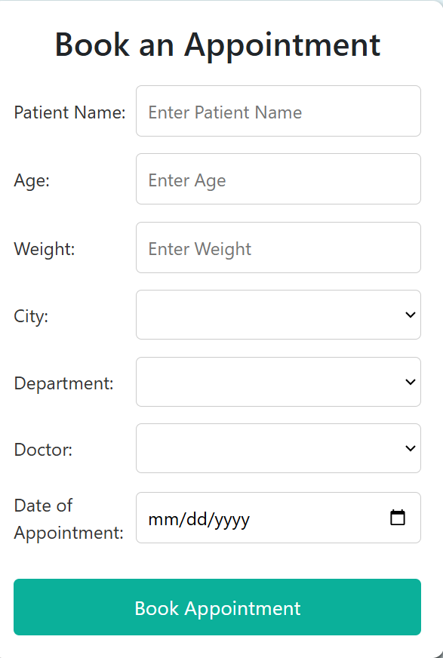
Appointment Bookings
You can add an appointment.
Appointment can be viewed in the manage-appointment component.

Slide 11
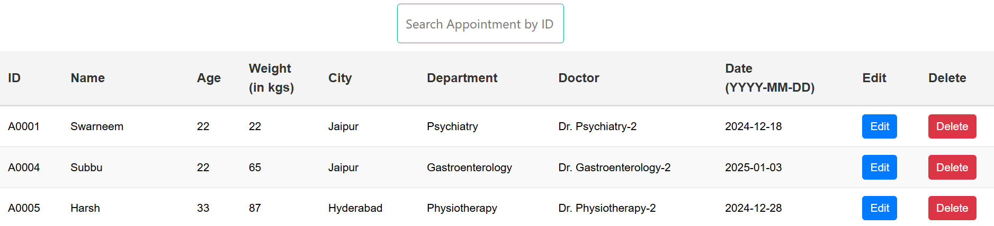
Managing the appointments
You can view the appointments in manage appointments.
Appointments can be edited or deleted here.
The appointment id will be generated in A0000 format

Slide 12
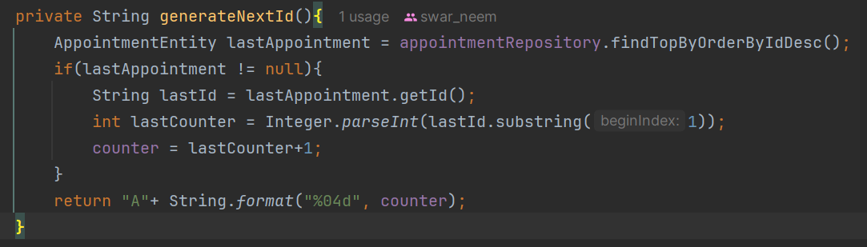
Unique ID generation in backend

Slide 13
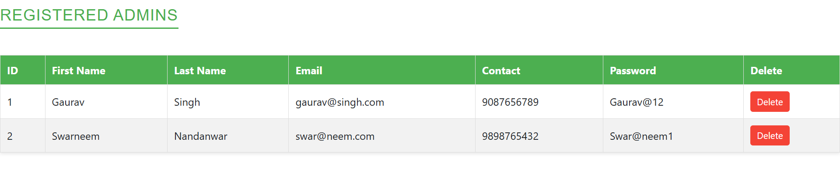
Managing Admins
You can view the registered admins in manage admins.

Slide 14
Key Learnings
How to effectively use angular component.
Generating tables automatically using hibernate.
Database connectivity using springboot.
Performing CRUD operations on the database using springboot.

Slide 15
Thank You!

